Slide 1
Tuesday 5th 2020

Slide 2
Year 3/4 – Summer Block 1 – Money
Step 3
5.05.20
Year 3/4: I can use rounding to estimate money

Slide 3
Introduction
Round each number to the nearest 100 and match
it to the number line.
851
126
575
386
100 | 200 | 300 | 400 | 500 | 600 | 700 | 800 | 900
164
849
270
548
655
Y3

Slide 4
Introduction
Round each number to the nearest 100 and match
it to the number line.
164
386
575
849
100 | 200 | 300 | 400 | 500 | 600 | 700 | 800 | 900
126
270
548
655
851
Y3

Slide 5
Varied Fluency 1
Which whole pounds does the given amount come in between?
Round the amount to the nearest pound.
£7.82
Y4

Slide 6
Varied Fluency 1
Which whole pounds does the given amount come in between?
Round the amount to the nearest pound.
£8.00
£7.82
£7.00
£8.00
Y4

Slide 7
Varied Fluency 2
Match the amounts to the letters on the number line.
A
B
C
£5
£6
£5.95
559p
£5.05
Y4

Slide 8
Varied Fluency 2
Match the amounts to the letters on the number line.
A
B
C
£5
£6
£5.95 | C
559p | B
£5.05 | A
Y4

Slide 9
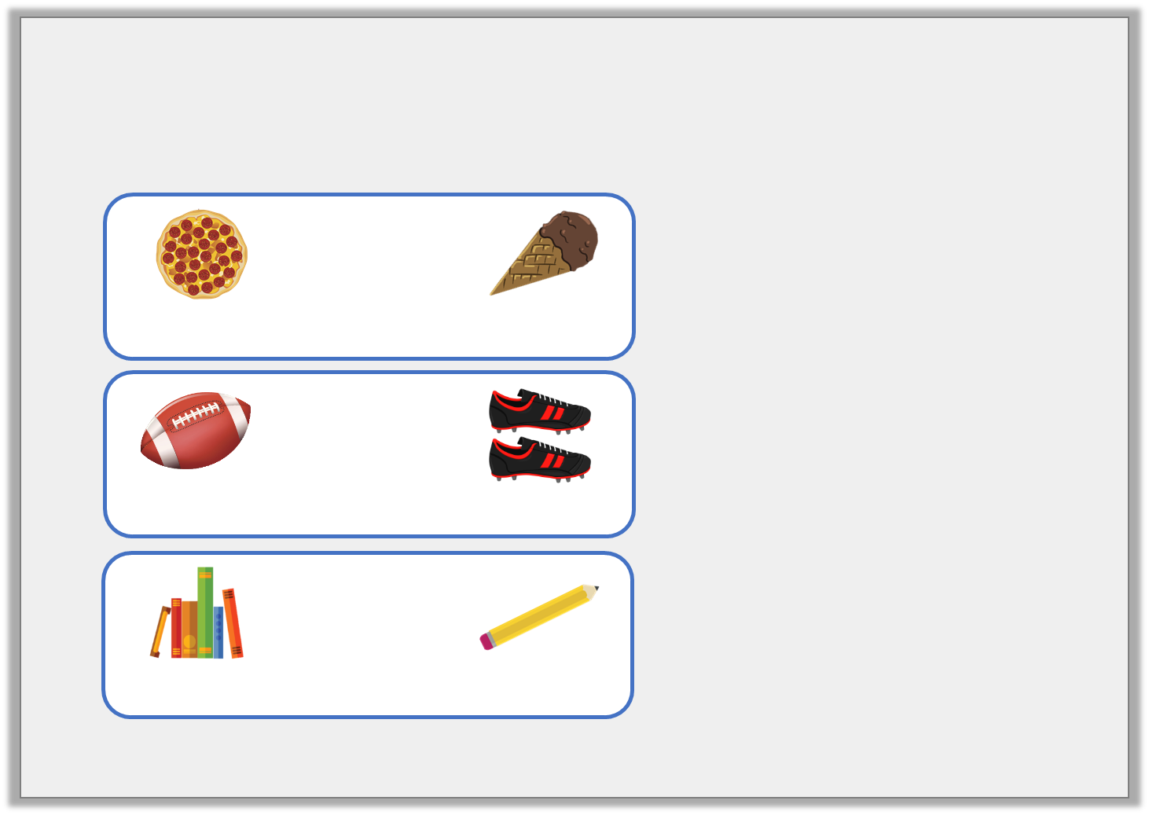
Varied Fluency 3
Match the items to the rounded totals.
 | +
468p |  | £1.67
£4.00
£7.00
£9.00
 | +
225p |  | £6.89
 | +
£3.44 |  | 72p
Y4

Slide 10
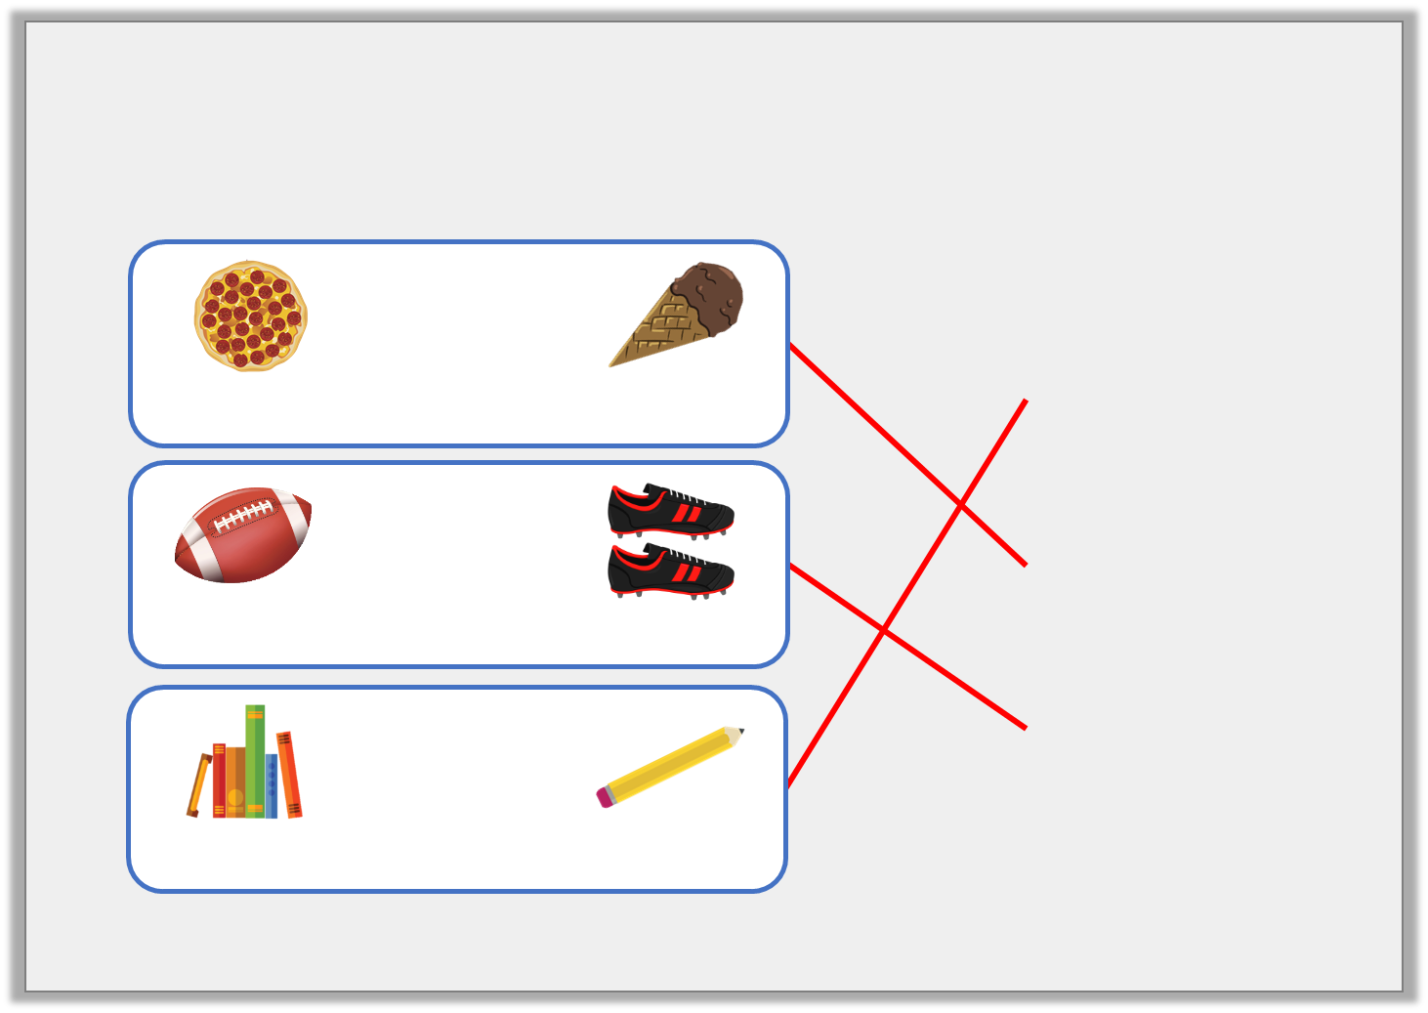
Varied Fluency 3
Match the items to the rounded totals.
 | +
468p |  | £1.67
£4.00
£7.00
£9.00
 | +
225p |  | £6.89
 | +
£3.44 |  | 72p
Y4

Slide 11
Varied Fluency 4
James wants to buy a pair of shorts for £4.54
and a t-shirt for £5.28.
What does each amount round to?
He has £12.00.
How much change will he receive approximately?
Y4

Slide 12
Varied Fluency 4
James wants to buy a pair of shorts for £4.54
and a t-shirt for £5.28.
What does each amount round to?
£5.00 and £5.00
He has £12.00.
How much change will he receive approximately?
£12 – £10 = £2.00
Y4

Slide 13
Wednesday 6th May 2020 Lo: Year 3/4: I can use rounding to estimate money using reasoning and problem – solving

Slide 14
Reasoning 1
What amount could the arrow be pointing to?
Explain why.
500p
600p
Y4

Slide 15
Reasoning 1
What amount could the arrow be pointing to?
Explain why.
The arrow is pointing to less than a quarter of the way along the number line, so the amount must be less than…
500p
600p
Y4

Slide 16
Reasoning 1
What amount could the arrow be pointing to?
Explain why.
The arrow is pointing to less than a quarter of the way along the number line, so the amount must be less than 525p or £5.25. The price could be between £5.10 or 510p and £5.20 or 520p.
500p
600p
Y4

Slide 17
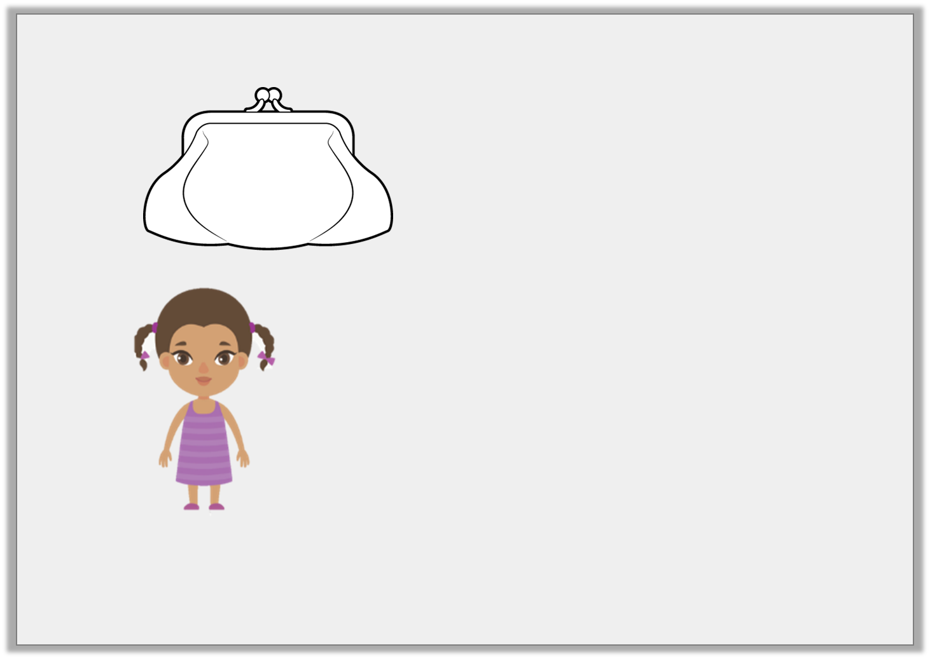
Reasoning 2
Cleo has:
She says,
Do you agree? Explain why.
£2.32
My amount rounds to £3.
Y4

Slide 18
Reasoning 2
Cleo has:
She says,
Do you agree? Explain why.
I disagree because…
£2.32
My amount rounds to £3.
Y4

Slide 19
Reasoning 2
Cleo has:
She says,
Do you agree? Explain why.
I disagree because any amount less than £2.50 rounds down to £2.00. £2.32 is less than £2.50 and is nearer to £2.00 than £3.00.
£2.32
My amount rounds to £3.
Y4

Slide 20
Problem Solving 1
Kaylum has these digit cards:
Find all the amounts he can make which round to 500p.
5
4
1
9
Y4

Slide 21
Problem Solving 1
Kaylum has these digit cards:
Find all the amounts he can make which round to 500p.
491p 514p
495p 519p
451p 541p
459p 549p
5
4
1
9
Y4

Slide 22
Thursday 7th May 2020

Slide 23
Year 3/4 – Summer Block 1 – Money
Step 4
Year 3: I can add money

Slide 24
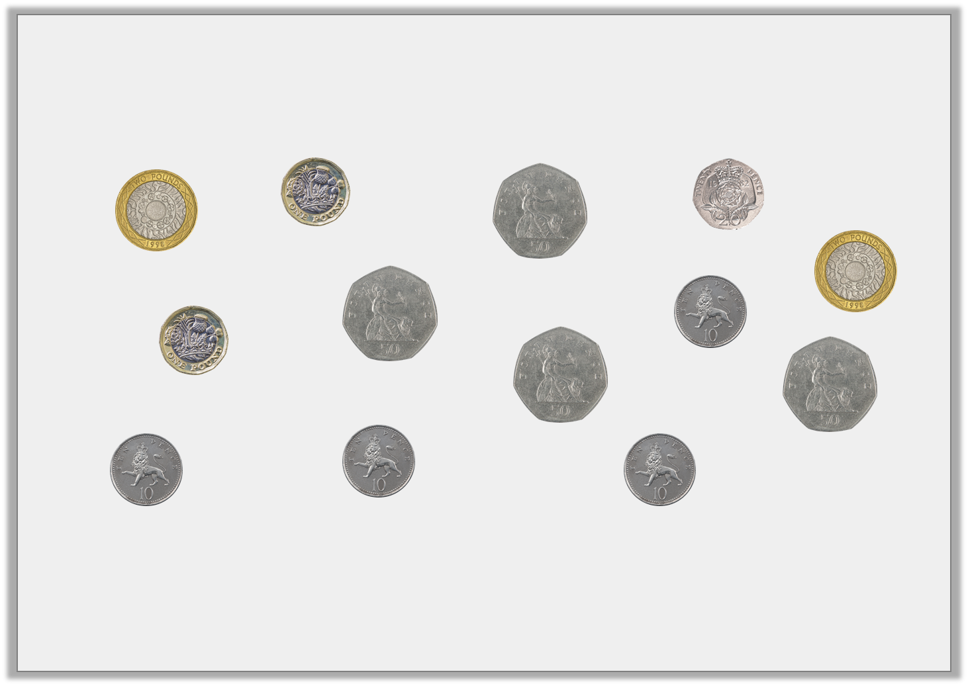
Introduction
How many different ways can you make a total of £4 and 50p using the following coins?
Y3

Slide 25
Introduction
How many different ways can you make a total of £4 and 50p using the following coins?
Possible answers include:
£2, £2 and 50p; £2, £1, £1 and 50p; £2, £1, 50p, 50p, 50p;
£2 coin, 50p, 50p, 50p, 50p, 20p, 10p, 10p, 10p
Y3

Slide 26
Varied Fluency 1
Complete the addition represented on this number line.
£4 and 20p | + |  | =
80p
£3 and 5p
£4 and 20p
£5
Y3

Slide 27
Varied Fluency 1
Complete the addition represented on this number line.
£4 and 20p | + | £3 and 85p | = | £8 and 5p
80p
£3 and 5p
£4 and 20p
£5
£8 and 5p
Y3

Slide 28
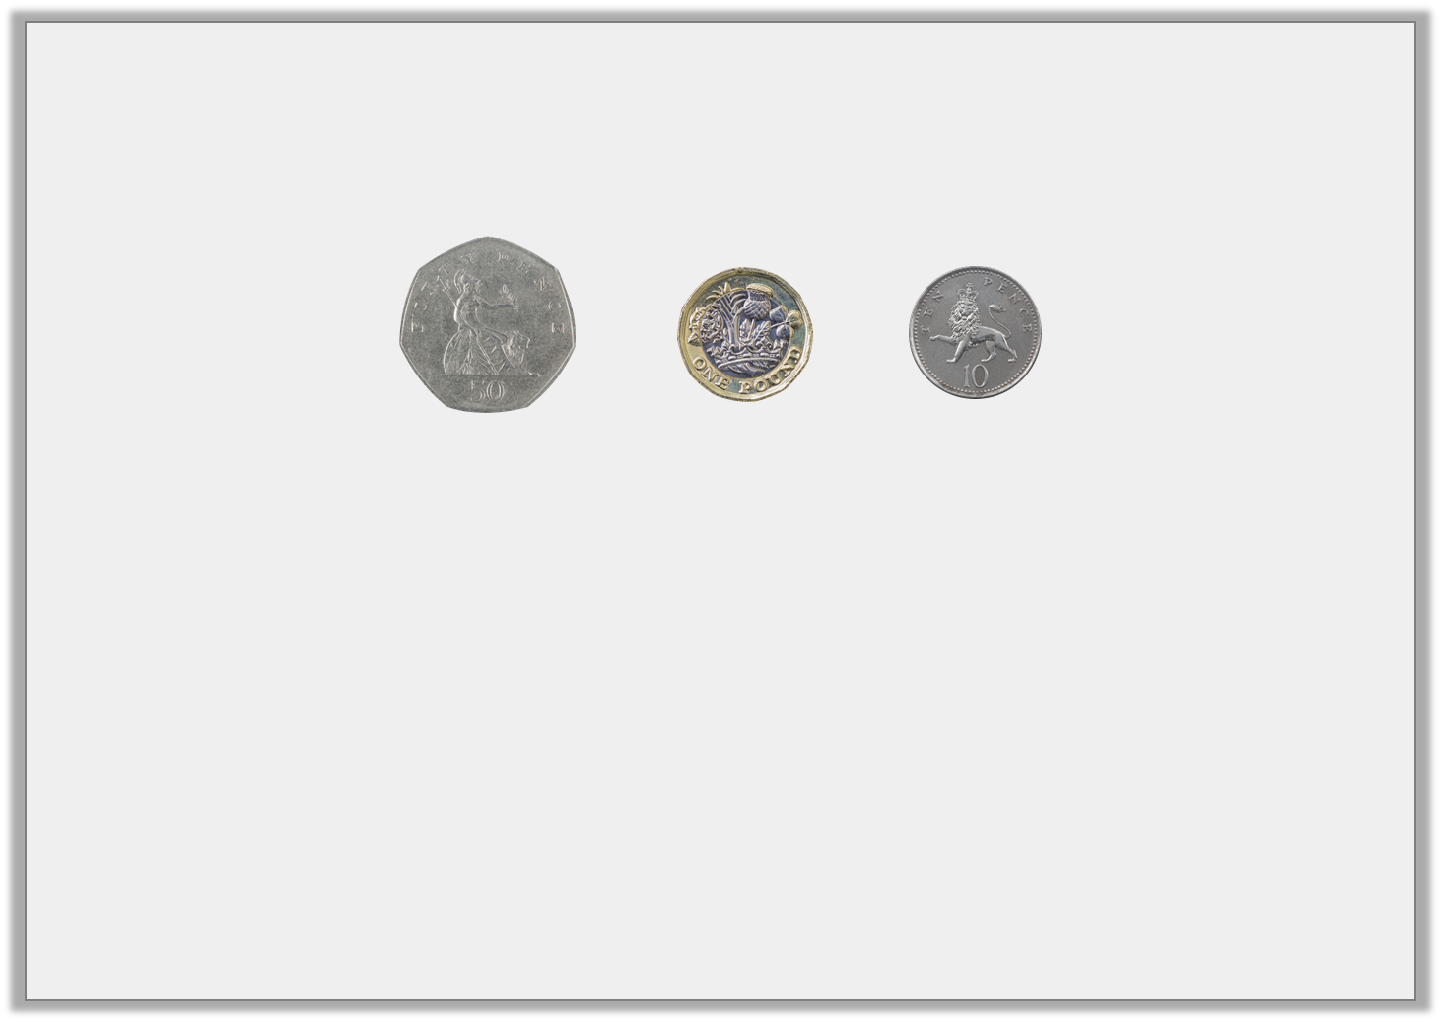
Varied Fluency 2
Jilani had this much money.
His friend gave him £6 and 70p more.
How much does he have altogether?
Y3

Slide 29
Varied Fluency 2
Jilani had this much money.
His friend gave him £6 and 70p more.
How much does he have altogether? £8 and 30p
Y3

Slide 30
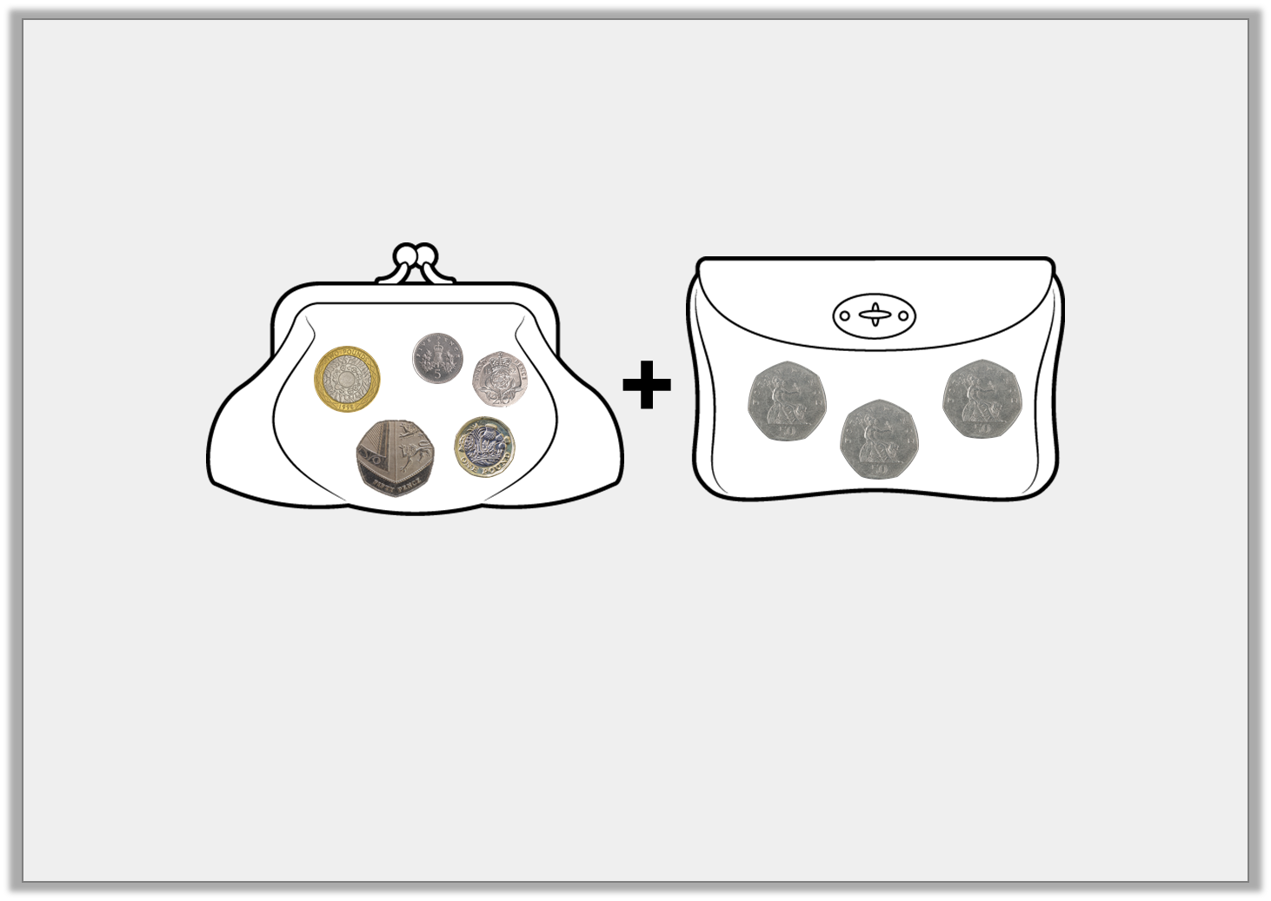
Varied Fluency 3
Find the total amount of money in these two purses.
Show your calculation.
Y3

Slide 31
Varied Fluency 3
Find the total amount of money in these two purses.
Show your calculation.
£3 and 75p + £1 and 50p = £5 and 25p
Y3

Slide 32
Varied Fluency 4
Complete this sum.
£2 and 85p | + | 435p | =
Y3

Slide 33
Varied Fluency 4
Complete this sum.
£2 and 85p | + | 435p | = | £7 and 20p
Y3

Slide 34
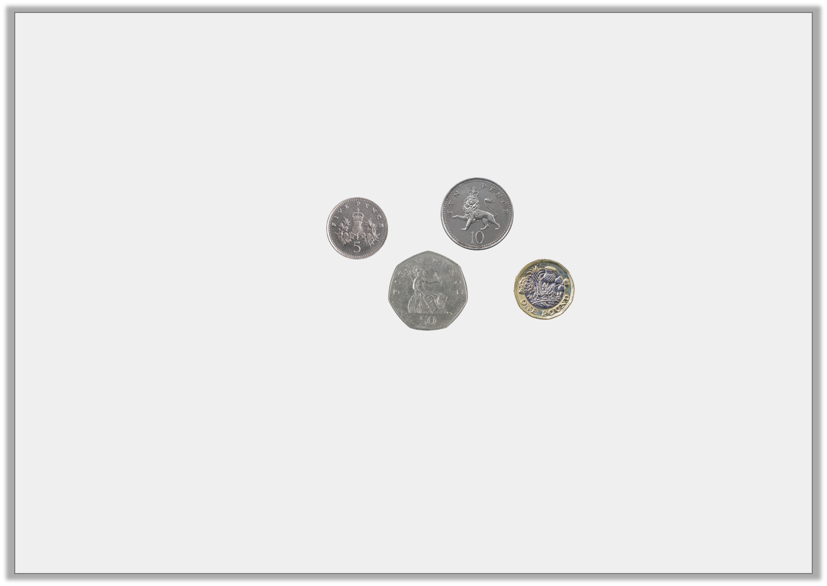
Varied Fluency 5
True or false?
£2 and 90p | + |  | > | £4 and 50p
Y3

Slide 35
Varied Fluency 5
True or false?
True
£2 and 90p | + |  | > | £4 and 50p
Y3

Slide 36
Friday 8th May 2020 Year 3: I can add money using reasoning and problem-solving

Slide 37
Problem Solving 1
Add 2 amounts to make a total less than £5.
Find all the possibilities.
£1 and 85p
£3 and 80p
270p
Four pounds and five pence
15p
Y3

Slide 38
Problem Solving 1
Add 2 amounts to make a total less than £5.
Find all the possibilities.
£1 and 85p + 270p = £4 and 55p; £1 and 85p + 15p = £2;
270p + 15p = £2 and 85p; £4 and 5p + 15p = £4 and 20p;
15p + £4 and 30p = £4 and 45p; £3 and 80p + 15p = £3 and 95p
£1 and 85p
£3 and 80p
270p
Four pounds and five pence
15p
Y3

Slide 39
Problem Solving 2
Samuel has used coins to show the solution to this problem.
There are 5 coins hidden by the splat. What could they be?
£4 and 55p | + | £1 and 85p | =
£4 and 55p | + | £1 and 85p | =
Y3

Slide 40
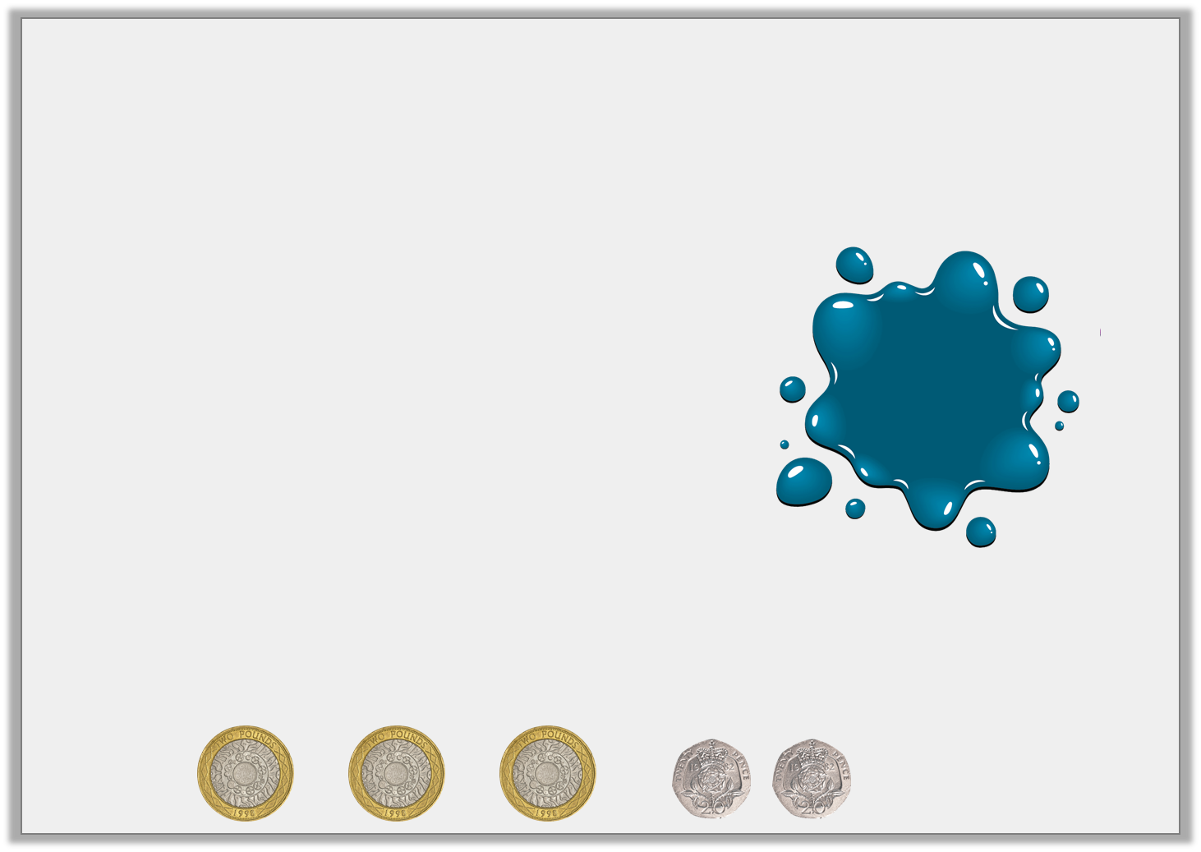
Problem Solving 2
Samuel has used coins to show the solution to this problem.
There are 5 coins hidden by the splat. What could they be?
£6 and 40p can be made using the following coins:
£4 and 55p | + | £1 and 85p | =
Y3

Slide 41
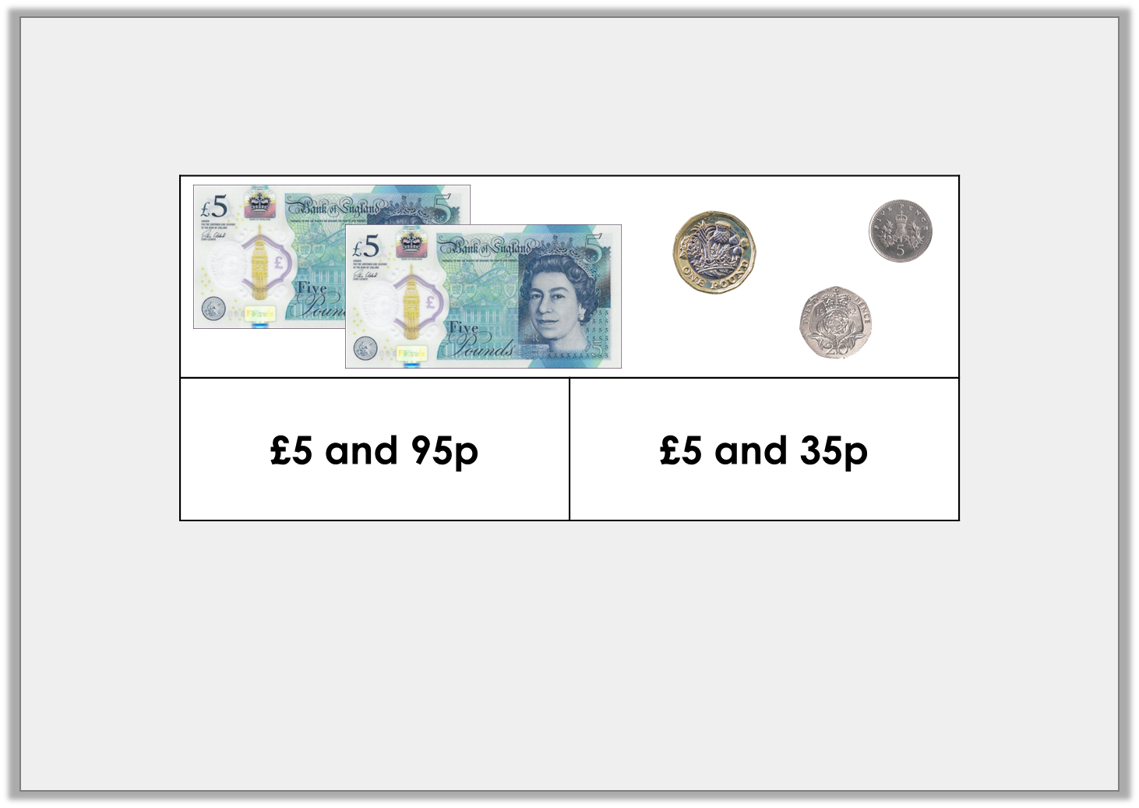
Reasoning 1
Sanjay has used this bar model to represent an addition.
He thinks he has lost a silver coin. Do you agree? Explain your reasoning.
Y3

Slide 42
Reasoning 1
Sanjay has used this bar model to represent an addition.
He thinks he has lost a silver coin. Do you agree? Explain your reasoning.
I agree because…
Y3

Slide 43
Reasoning 1
Sanjay has used this bar model to represent an addition.
He thinks he has lost a silver coin. Do you agree? Explain your reasoning.
I agree because the total is £11 and 30p so he has lost a 5p coin.
Y3

